Slide 1

BYU Men’s Soccer Statistical Research
McKade Thomas and Matthew Morgan
Mentor: Dr. Gilbert Fellingham

Slide 2


Background on BYU’s Performance
BYU plays in the Collegiate Club Division of soccer and have put up an impressive performance over the last two years since joining this division:
They remain undefeated in Club play with an unbeaten streak of 31 games in their league alone
After winning the 2017 national championship, BYU made another great run in the National Intramural and Recreational Sports Association (NIRSA) Tournament this past season where they advanced to the Elite 8.

Slide 3
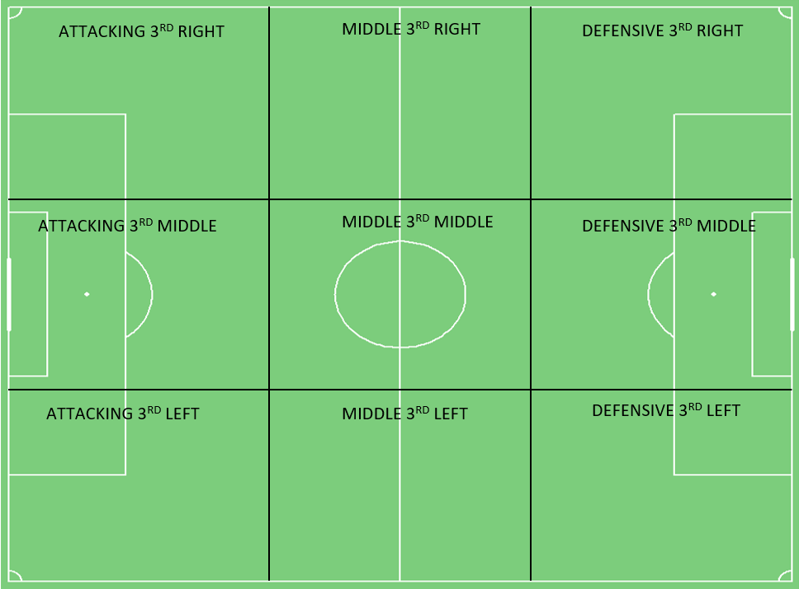
Location of Play Zone Breakdown
Important Terms:
Attacking 3rd = the third of the pitch with the opponent’s goal
Middle 3rd = the middle third of the pitch
Defensive 3rd = the third of the pitch where a team defends their own goal
GOALIE

Slide 4
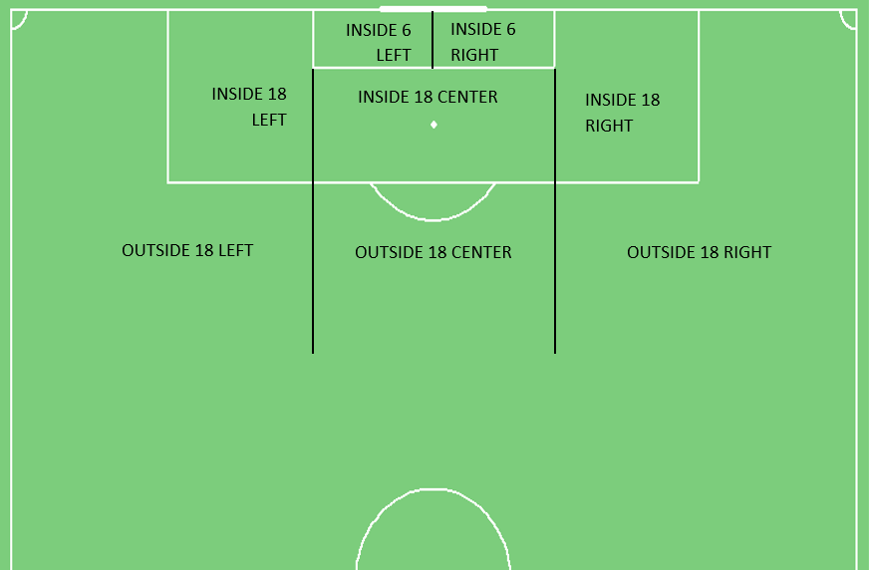
Scoring Zone Breakdown
Important Terms:
Inside 6 = The area inside the 6-yard box
Inside 18 = The area inside the 18-yard box
Outside 18 = The area outside the 18-yard box

Slide 5
Research Inquiries/Methods
Hypothesis Questions:
Where in the Attacking 3rd is BYU most effective at taking shots on goal? At scoring goals?
What type of play is the most effective start of build-up to lead to a score?
Where on the pitch is BYU most effective at creating goals?
Data collection methods:
Data collected from watching film of BYU’s 6 home games in the Collegiate Club Division
R, Plotly, Excel, CSV, YouTube Film

Slide 6
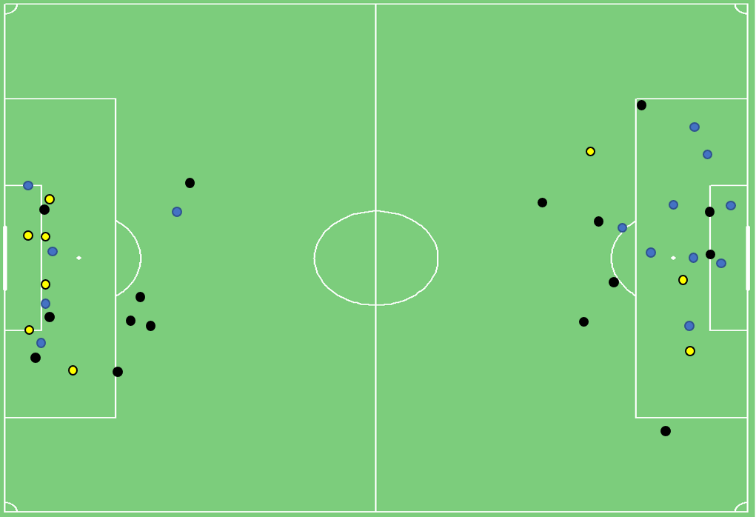
Methods of Data Collection: Shots
Shot Plot from the BYU v SUU game
(1st Half on the Right)
= Miss
= Shot on Goal
= Goal

Slide 7
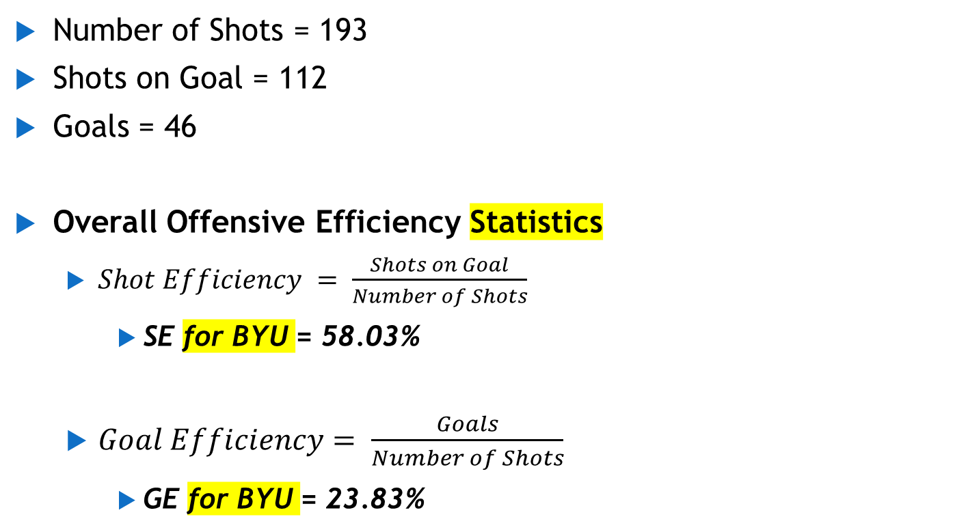
BYU Shot Efficiency Summary Statistics
Number of Shots = 193
Shots on Goal = 112
Goals = 46
Overall Offensive Efficiency Statistics
$Shot Efficiency = \frac{Shots on Goal}{Number of Shots}$
SE for BYU = 58.03%
$Goal Efficiency= \frac{Goals}{Number of Shots}$
GE for BYU = 23.83%

Slide 8
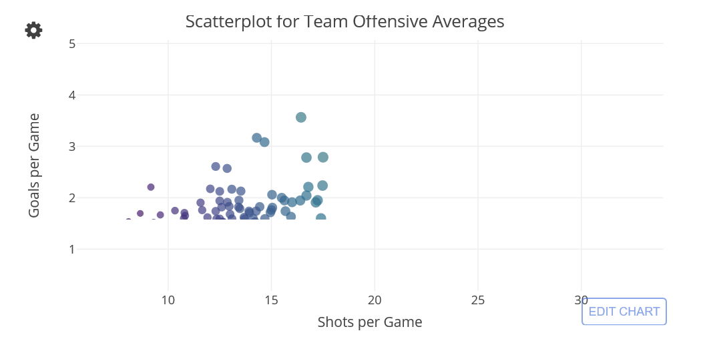
Comparing BYU to Professional Teams

Slide 9
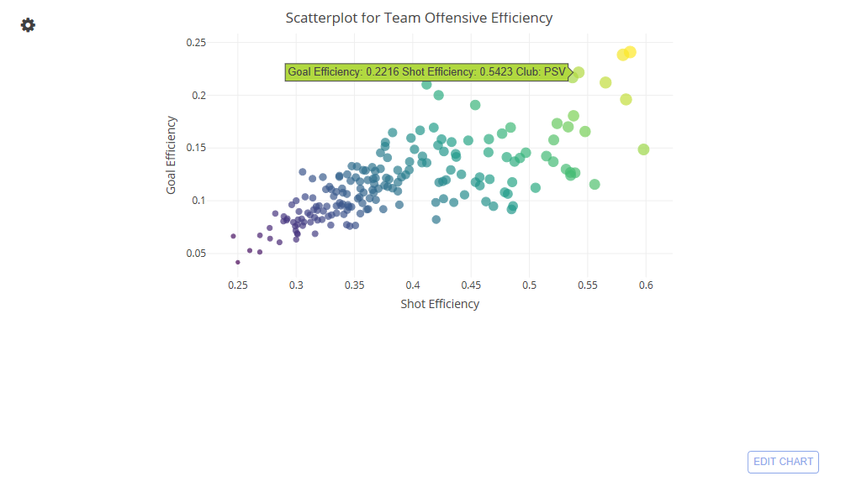
Comparing BYU to Professional Teams

Slide 10
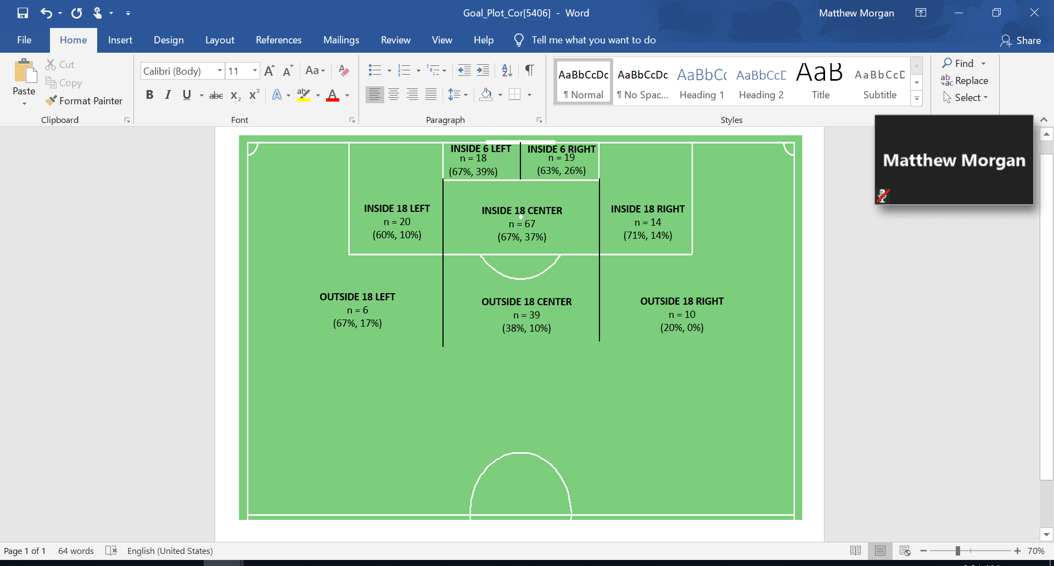
Maximization of Shot Efficiency
n = Number of shots from each zone
(SE%, GE%)
Max Number of Shots: Inside 18 Center (n = 67)
Max SE%: Inside 18 Right (SE = 71%)
Max GE%: Inside 6 Left (GE = 39%)

Slide 11
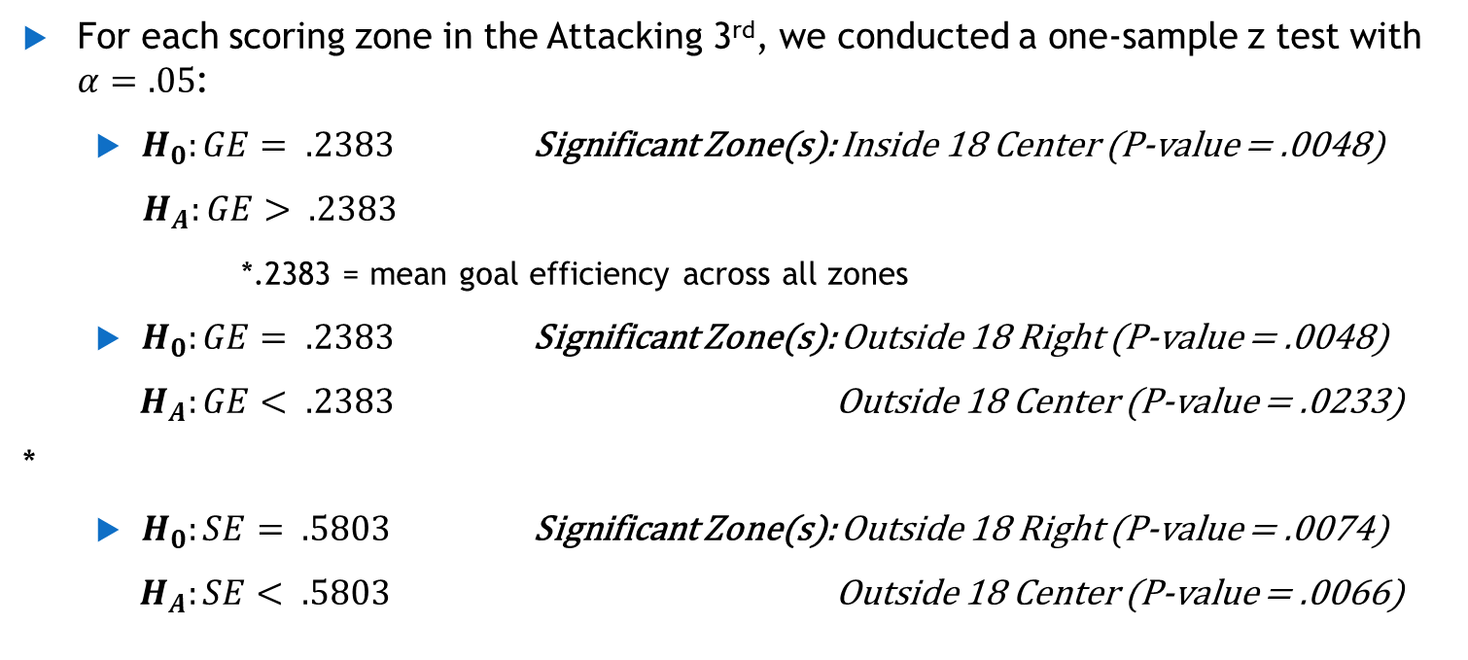
Statistical Analysis on Shot Efficiency
For each scoring zone in the Attacking 3rd, we conducted a one-sample z test with $α=.05$:
$H_{0}:GE= .2383$ Significant Zone(s): Inside 18 Center (P-value = .0048)
$H_{A}:GE> .2383$
*.2383 = mean goal efficiency across all zones
$H_{0}:GE= .2383$ Significant Zone(s): Outside 18 Right (P-value = .0048)
$H_{A}:GE< .2383$ Outside 18 Center (P-value = .0233)
*
$H_{0}:SE= .5803$ Significant Zone(s): Outside 18 Right (P-value = .0074)
$H_{A}:SE< .5803$ Outside 18 Center (P-value = .0066)
Summary: The Inside 18 Center Zone was the best zone for scoring (Goal Efficiency) for BYU while the Outside 18 Right and Center Zones proved to be the lowest zones for both shot accuracy and goal scoring.

Slide 12
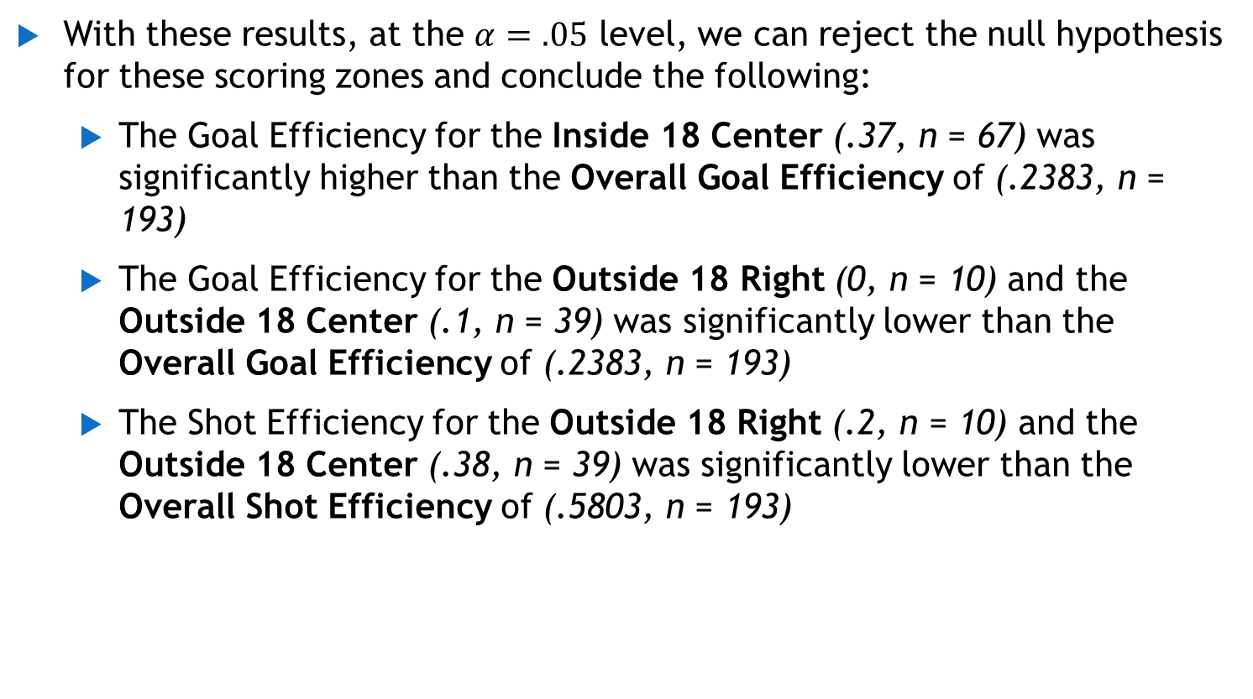
Statistical Conclusions on Shot Efficiency
With these results, at the $α=.05$ level, we can reject the null hypothesis for these scoring zones and conclude the following:
The Goal Efficiency for the Inside 18 Center (.37, n = 67) was significantly higher than the Overall Goal Efficiency of (.2383, n = 193)
The Goal Efficiency for the Outside 18 Right (0, n = 10) and the Outside 18 Center (.1, n = 39) was significantly lower than the Overall Goal Efficiency of (.2383, n = 193)
The Shot Efficiency for the Outside 18 Right (.2, n = 10) and the Outside 18 Center (.38, n = 39) was significantly lower than the Overall Shot Efficiency of (.5803, n = 193)

Slide 13
Statistical Summary on Shot/Goal Efficiency by Zone
Summary: The Inside 18 Center Zone was the best zone for scoring (Goal Efficiency) for BYU while the Outside 18 Right and Center Zones proved to be the lowest zones for both shot accuracy and goal scoring.

Slide 14
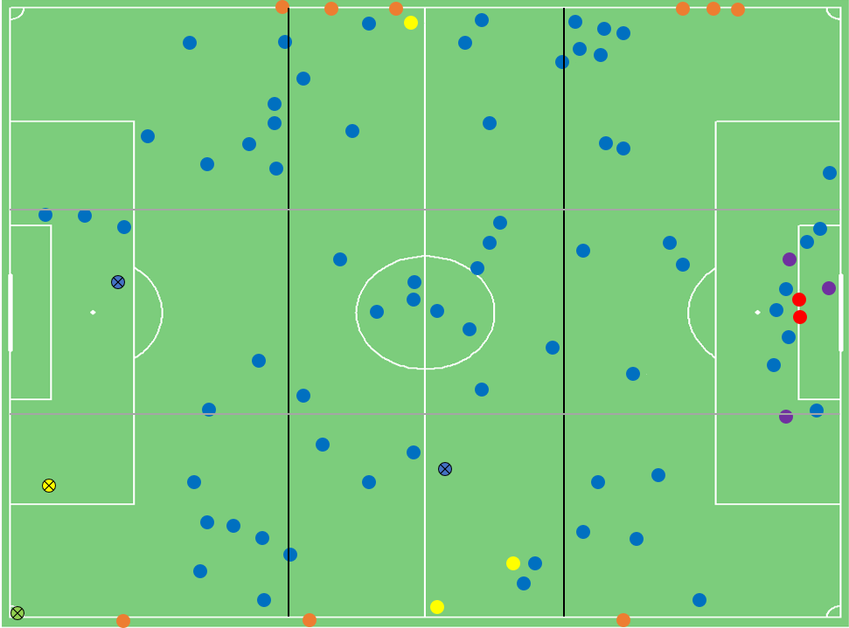
Methods of Data Collection: Location of Play
BYU vs Utah (2nd Half)
= Goal Kick
= Throw-In
= BYU is Fouled
= Start at Half/Corner
= Steal
= From Keeper
= Start to a Goal
GOALIE

Slide 15
Location of Play Summary Statistics
Total Number of Starts of Possession = 996
Steals = 743 (75%)
Throw-Ins = 118 (12%)
BYU is Fouled = 63 (6%)
Goal Kicks = 32 (3%)
From Keeper = 30 (3%)
Start at Half/Corner = 10 (1%)
Overall, a majority of BYU’s possessions start as STEALS

Slide 16
Most Effective Play Type
BYU had 46 starts of possessions (out of 996) that lead to goals. Here is the breakdown of what type of possession led to those goals:
Steals = 28 goals (60.87%)
Fouls = 8 goals (17.39%)
Throw-Ins = 5 goals (10.87%)
Corners = 3 goals (6.52%)
Starts at Half = 1 goal (2.17%)
From Keeper = 1 goal (2.17%)
Goal Kicks = 0 goals (0%)
With this breakdown, it is easy to see that BYU is most effective creating goals when they start their possession with a STEAL.

Slide 17
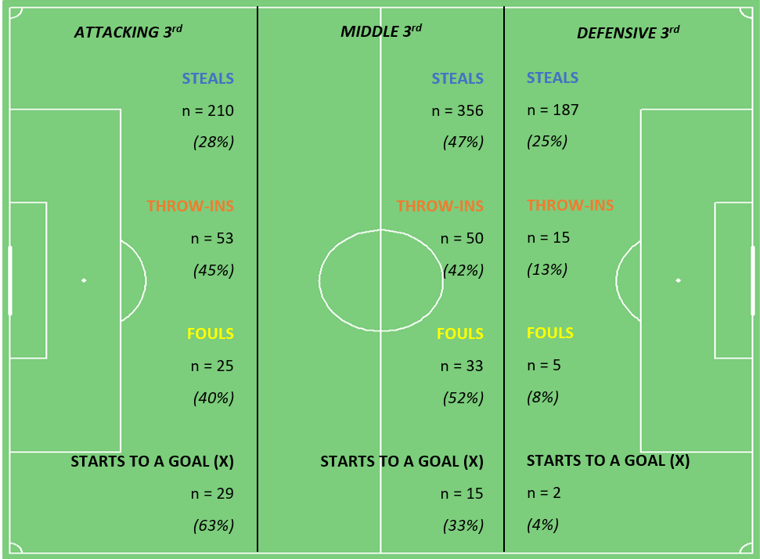
Location of Play Breakdown by Thirds
BYU got a majority of their STEALS and FOULS in the Middle 3rd
BYU got a majority of their THROW-INS from the Attacking 3rd
While BYU may have gotten a majority of their possessions from the Middle 3rd, a majority of their possessions that led to goals came from the Attacking 3rd
GOALIE

Slide 18
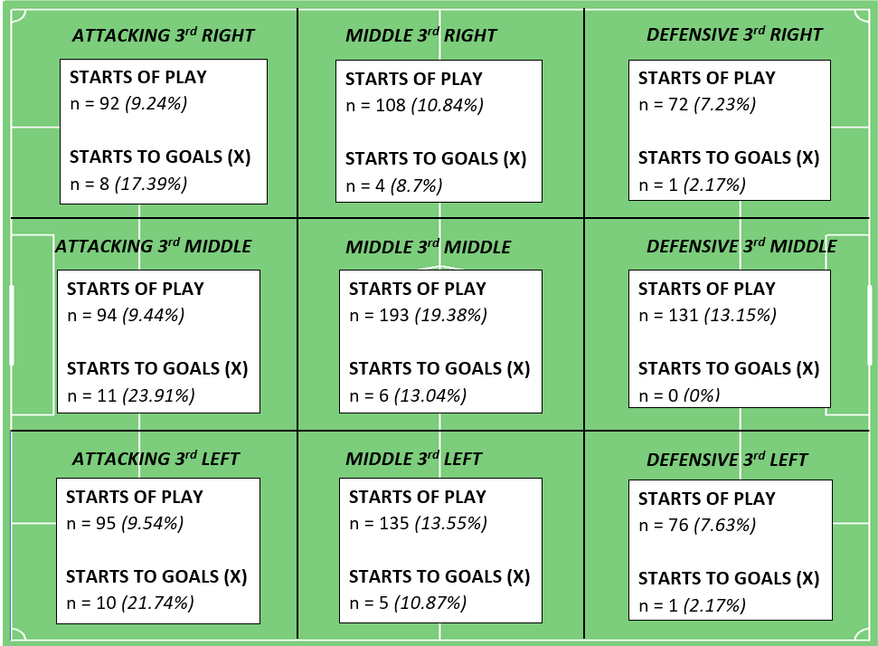
Pitch Zone Efficiency
The zone where BYU started the highest proportion of their possessions was the Middle 3rd Middle, where BYU started 19.38% of their possessions.
The zone where BYU started the lowest proportion of their possessions was the Defensive 3rd Right, where BYU started only 7.23% of their possessions.
GOALIE

Slide 19
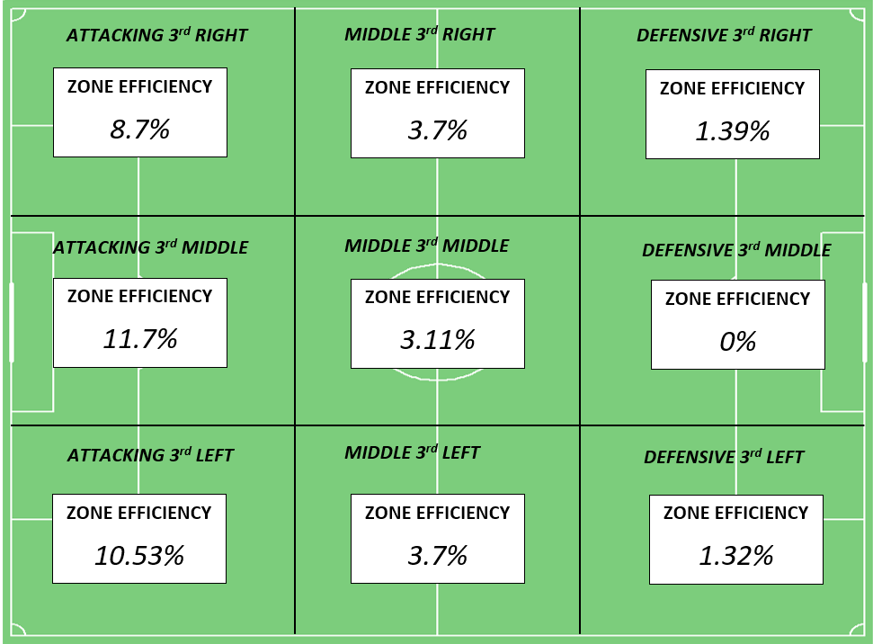
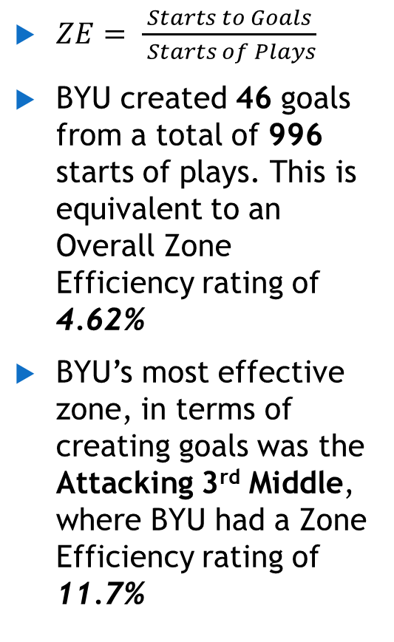
Pitch Zone Efficiency
$ZE= \frac{Starts to Goals}{ Starts of Plays}$
BYU created 46 goals from a total of 996 starts of plays. This is equivalent to an Overall Zone Efficiency rating of 4.62%
BYU’s most effective zone, in terms of creating goals was the Attacking 3rd Middle, where BYU had a Zone Efficiency rating of 11.7%
GOALIE

Slide 20
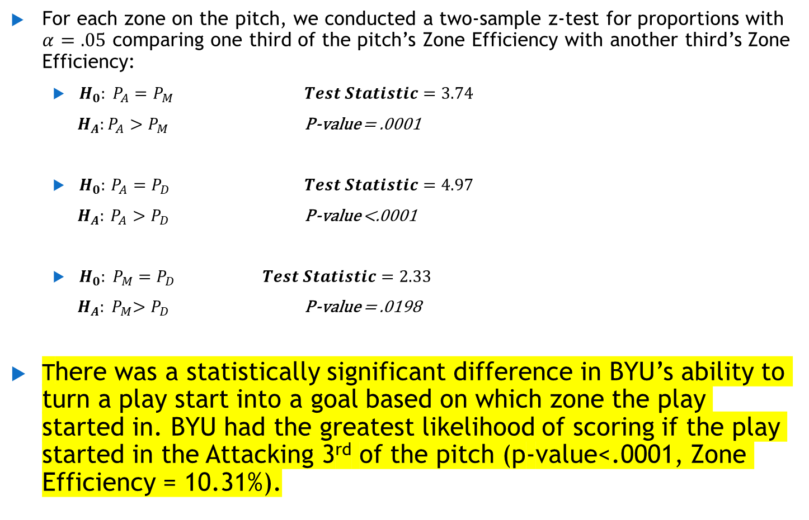
Statistical Analysis on Zone Efficiency
For each zone on the pitch, we conducted a two-sample z-test for proportions with $α=.05$ comparing one third of the pitch’s Zone Efficiency with another third’s Zone Efficiency:
$H_{0}: P_{A}=P_{M}$ $Test Statistic=3.74$
$H_{A}:P_{A}>P_{M}$ P-value = .0001
$H_{0}:$ $P_{A}=P_{D}$ $Test Statistic=4.97$
$H_{A}:$ $P_{A}>P_{D}$ P-value <.0001
${H_{0}: P}_{M}=P_{D}$ $Test Statistic=2.33$
${ H_{A}: P}_{M}>P_{D}$ P-value = .0198
There was a statistically significant difference in BYU’s ability to turn a play start into a goal based on which zone the play started in. BYU had the greatest likelihood of scoring if the play started in the Attacking 3rd of the pitch (p-value<.0001, Zone Efficiency = 10.31%).

Slide 21
Tactical Conclusions
In the Attacking 3rd, BYU is most effective at getting Goals from the Inside 18 Center Zone
(Goal Efficiency = 37%)
BYU’s most effective start of possession, in term of creating goals, is a steal
(60.87% of goals came from steals)
BYU’s most effective area of the pitch for creating goals was the Attacking 3rd
(Zone Efficiency = 10.32%)

Slide 22
Tactical Conclusions
Implications for future play:
BYU should send the ball forward from the defense and have their forwards go for steals from the opposing teams defense rather than trying to work the ball up from their own Defensive 3rd.
BYU should focus on having their forwards play tight defense to win the ball back deep in the opposing side of the field, creating a short field in the Attacking 3rd to allow more starts of possession there.
When BYU is in the Attacking 3rd, they should work the ball into the center of the 18 yard box to shoot rather than attempting shots from outside the 18.

Slide 23
QUESTIONS?

